Slide 1
Machine learning
Chris Geggis
2/9/2023

Slide 2
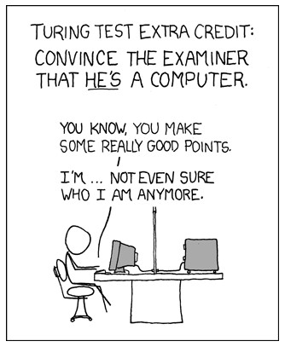
Attendance or quiz?

Slide 3
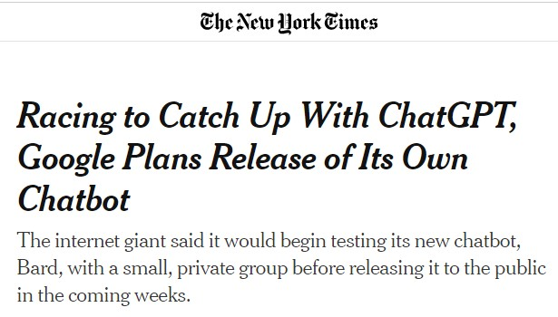
NY Times Monday (2/6/23)

Slide 4
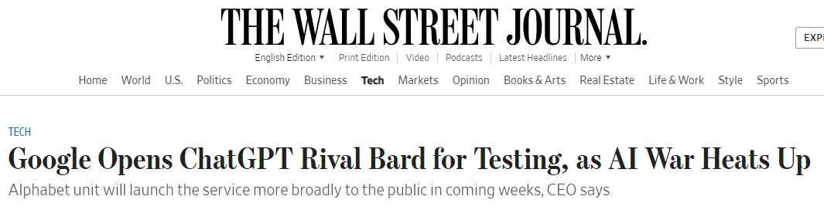
Wsj Monday (2/6/23)

Slide 5
Chapter 19 learning from examples
An agent is learning if it improves its performance after making observations about the world
When the agent is a computer, we call it machine learning
A computer observes data, builds a model based on the data, and uses the model to build a hypothesis about the world and a piece of software that can solve problems
Chapter 19 assumes little prior knowledge on the part of the agent (computer); it starts from scratch and learns from the data.
The next chapter we will study (21) will consider transfer learning; knowledge from one domain is transferred to a new domain, so learning can proceed faster with less data

Slide 6
Forms of learning
Going from a specific set of observations to a general rule is called induction
Induction differs from deduction because inductive conclusions may be incorrect, whereas deductive conclusions are guaranteed to be correct if the premises are correct
When the output is one of a finite set of values (e.g. sunny/rainy/cloudy) the learning problem is called classification
When the output is a number (e.g. 0-9 in the HW), the learning problem has the name regression (although the AI author(s) would prefer function approximation or numeric prediction)
This is not the same as regression tests in Software Engineering

Slide 7
Forms of learning - feedback
In supervised learning the agent observes input-output pairs and learns a function that maps input to output. Mention labels in HW example.
In unsupervised learning the agent learns patterns without any explicit feedback. The most common unsupervised learning task is clustering: detecting useful clusters of input examples. For example, a computer vision system could cluster similar looking objects after looking at millions of images.
In reinforcement learning the agent learns from a series of reinforcements: rewards and punishments. The agent decides which actions prior to the reinforcement were most responsible for it and alters its actions in the future. Mention HW example, again.

Slide 8
Supervised learning
A training set is made up of input-output pairs (x₁, y₁),(x₂, y₂)…
y = f(x)
The agent makes a hypothesis (h) about the world, drawn from a hypothesis space
h is a model of the data, drawn from a model class (H), or alternatively a function drawn from a function class
The output, y_{i}, is called the ground truth, is the true answer we are asking the model to predict

Slide 9
Supervised learning
To choose a hypothesis space we can use prior knowledge, or perform exploratory data analysis by examining the data with statistical tests and visualizations – histograms, scatter plots, box plots, or whatever seems appropriate
The hope and desire is to find a consistent hypothesis
The agent should look for a best-fit function in the hope that future predictions will be accurate
The training set (or data) is not the important part. It is the test set (or data) which has not been seen yet that is important.
We say that h generalizes well if it accurately predicts the output of the test set

Slide 10
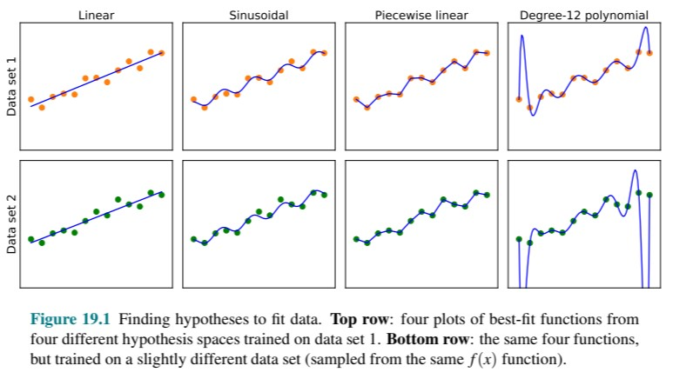

Slide 11
Supervised learning
A bias is the tendency of a predictive hypothesis to deviate from the expected value when averaged over different training sets
Not the same as a bias assigned to a perceptron, or the long list of other biases…
https://en.wikipedia.org/wiki/List_of_cognitive_biases
We say that a hypothesis is underfitting when it fails to find a pattern in the data
Variance is the amount of change in the hypothesis due to fluctuation in the training data. The 12th degree polynomial in the preceding figure is a good example of significant variance.

Slide 12
Supervised learning
A function is overfitting the data when it pays too much attention to the particular data set it is trained on, and performs poorly on unseen data
A bias-variance tradeoff refers to the tradeoffs between complex, low-bias hypotheses that fit training data, and simpler low-variance hypotheses that may generalize better.
Ockham’s razor is a term given to a preference for choosing the simplest hypothesis that matches the data

Slide 13
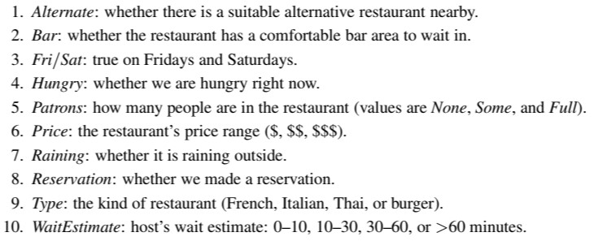
Learning decision trees
2⁶ x 3² x 4² = 9,216 possible combinations

Slide 14
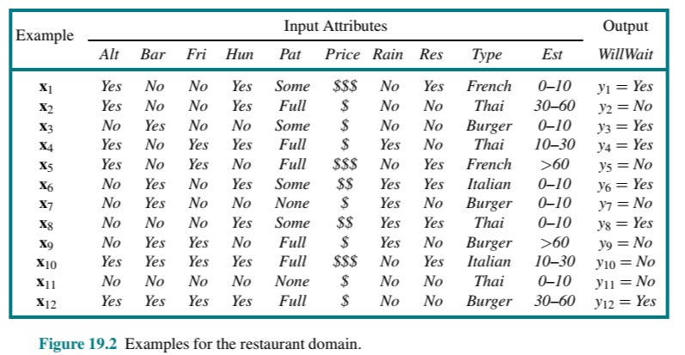
Learning decision trees
2⁶ x 3² x 4² = 9,216 possible combinations

Slide 15
Learning decision trees
A decision tree is a representation of a function that maps a vector of attribute values to a single output value – a “decision”
Decision trees end at a leaf node that returns a value to the function
Input-output values can be discrete or continuous
Our example considers only discrete values, and the outputs fall into a Boolean classification, where they are either true (positive = Yes) or false (negative = No)
A decision tree should start with the “most important attribute”

Slide 16
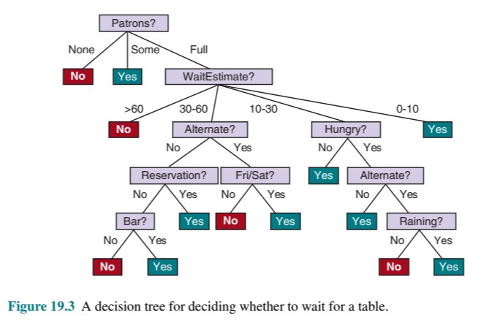
Learning decision trees

Slide 17
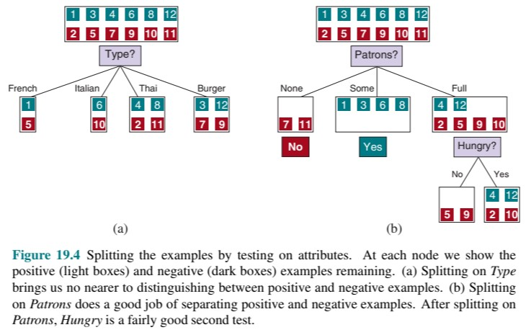
Learning decision trees

Slide 18
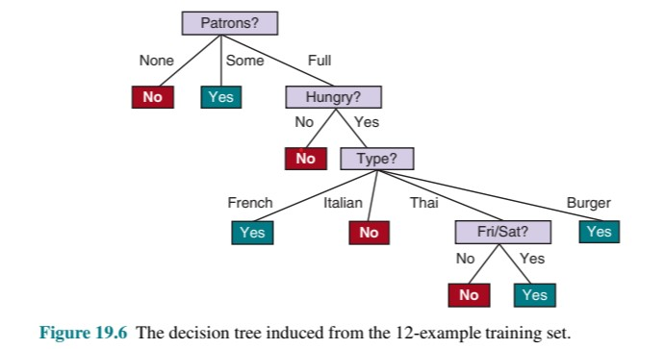
Learning decision trees

Slide 19
Learning decision trees
If some examples have the same input values, but different output values then there is an error or noise in the data
Noise happens when the domain is non-deterministic, or when there is an attribute which cannot be observed
We evaluate the performance of a learning algorithm with a learning curve

Slide 20
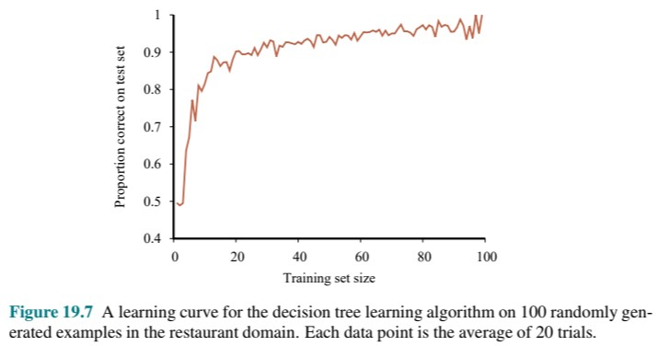
Learning decision trees (happy Graphs)

Slide 21
Learning decision trees
We choose the attributes with the highest importance, using the notion of information gain, which is defined in terms of entropy. (Claude Shannon, 1949)
Entropy is a measure of the uncertainty of a random variable.
Entropy in physics is a measure of order, or disorder, or randomness
More information = Less entropy
The information gain from an attribute test is the expected reduction in entropy

Slide 22
Learning decision trees
Decision tree pruning eliminates nodes that are irrelevant
Finding nodes that are irrelevant using a statistical significance test
A significance test starts using the null hypothesis - there is no underlying pattern
Some chi-squared statistical math in book
Pick a measure, and let’s say any node below 5% significance gets pruned
Early stopping has the decision tree stop generating nodes when there is no good attribute to split on
Early stopping carries the risk that a different combination of nodes is significant

Slide 23
Decision tree – problems/solutions
Missing data, unrecorded or too expensive to obtain - not necessarily fixable
Continuous and multivalued input attributes, a split point test might fix, e.g. weight > 160, measuring the information gain ratio or an equality test can be used to avoid splitting (examples include zip codes and credit card numbers)
Continuous output attribute – predicting a numerical value is easier with a regression tree which can output a function instead of a value
CART – Classification And Regression Trees
Decision trees are unstable. Adding one example can change the root test for the tree. A random forest model (covered later) can help fix this issue

Slide 24
Model selection and optimization
First assumption - future examples will be like the past, otherwise all bets are off. This is called the stationary assumption.
Next, look for an optimal fit which minimizes the error rate. A training set creates the hypothesis and then performance can be measured and evaluated with a test set.
Hyperparameters can be used to tune the model. Recall the learning rate, the batch size, and the number of epochs from the HW

Slide 25
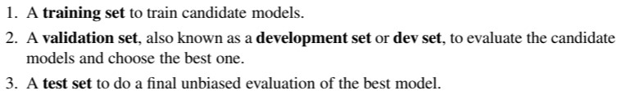
Model selection and optimization
Ideally we want 3 data sets
We would want to run the test set before we run it in the real world, especially if there are risks involved

Slide 26
Model selection and optimization
If we don’t have enough data for all three datasets, we can use the training data as validation data, but not at the same time. This technique is called k-fold cross-validation. You could do this by varying the batch sizes or the epochs (from the HW)
Finding a good hypothesis can be broken into two subtasks – model selection chooses a good hypothesis space, and optimization (aka training) finds the best hypothesis within that space.

Slide 27
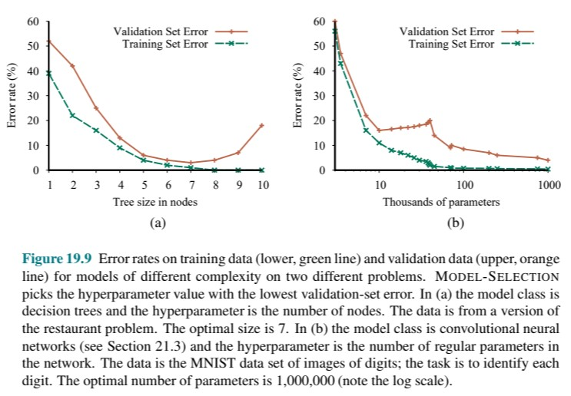
Model selection
We say that a model that exactly fits the training data has interpolated (or memorized) the data

Slide 28
Error rates and loss function
We want to minimize the error rate, but…
We need a loss function to help us in certain scenarios
In the spam, nospam example we might use a loss function that looks like this…
L(spam, nospam) = 1, L(nospam, spam) = 10, L(spam, spam) = 0, L(nospam, nospam) = 0
This means it is 10x worse to classify nospam as spam then visa versa
Correctly identifying spam vs nospam results in no loss, which is what we want

Slide 29
Error rate and loss function
If you know the prior probability distribution, you can calculate an expected generalization loss (math in book)
Using training data the prior probability distribution is not known, so you estimate the generalization loss and calculate an empirical loss (again, math in book)
We say that a problem is realizable if the hypothesis space contains the function that we are looking for
When different sets of examples return different hypotheses this is called variance, which decreases towards zero as training examples increase in a realizable hypothesis space.

Slide 30
Error rate and loss function
When we are trying to find a complicated function in a large hypothesis space it may be computationally intractable to systematically search all possibilities. In this case, a search can explore part of the space and return a reasonably good hypothesis, but not necessarily the best hypothesis.
Traditionally, small-scale learning had training examples which ranged from dozens to the low thousands
In recent years, large-scale learning deals with millions of examples

Slide 31
Error rate and loss function
If f (the hypothesis) is nondeterministic or noisy, it may return different values of f(x) for the same x
If the hypothesis space and/or function is complicated it can be computationally intractable to systematically search all possibilities. We settle for a good hypothesis, but we are aware that it may not be the correct one.
The early years of machine learning could only accommodate small-scale learning. Generalization loss cam from approximation errors for not having enough data
Recently there has been an emphasis on large-scale learning, with millions of examples. Now generalization loss is dominated by the limits of computation

Slide 32
Regularization
The process of explicitly penalizing complex hypotheses is called regularization
In quantum physics the same process is called normalization
The complexity measure is called the regularization function
Feature selection discards attributes that appear to be irrelevant
The minimum description length hypothesis is the minimum information required for the hypothesis correlated to a minimum loss

Slide 33
Hyperparameter tuning
Hyperparameters – for example…batch size, epoch, or learning rate
Hyperparameters are parameters that exist outside the model (i.e. NOT the weights and biases)
The simplest approach to hyperparameter tuning is hand-tuning Guess, tweak, repeat.
With just a few hyperparameters you can perform a systematic grid search. Try everything, until you find the best fit.
If there are too many combinations try a random search. If you look in Nielson’s code you’ll see that he seeds the parameters with random numbers when the model starts up.

Slide 34
Hyperparameter tuning
Bayesian optimization can be done as a machine learning problem. I.e. use machine learning to optimize machine learning.
If we trade off exploitation (choosing parameter values near a good result) with exploration (trying new parameter values), we call this a Gaussian process and it is similar to a Monte Carlo tree search
Population-based training starts with a random search tree that evolves the hyperparameters upon successive (generational) runs. It is like a cross between Bayesian optimization and the Gaussian process

Slide 35
Hollywood ending CS Movie (pick of the week)
The Social Dilemma (2020) [Netflix only?]
Explores the dangerous human impact of social networking, with tech experts sounding the alarm on their own creations.

